Slide 1
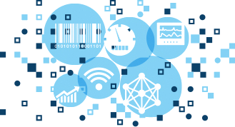
INFORMATION SYSTEM
UNIT 05: IMPLEMENTATION AND MAINTENANCE OF INFORMATION SYSTEMS
© 2018, PRAMOD PARAJULI

Slide 2
Disclaimer
These slides are part of teaching materials for Information System (IS). These slides do not cover all aspect of learning IS, nor are these to be taken as primary source of information. As the core textbooks and reference books for learning the subject has already been specified and provided to the students, students are encouraged to learn from the original sources.
Contents in these slides are copyrighted to the instructor and authors of original texts where applicable.

Slide 3
Implementation and maintenance of information systems
5.1. Overview of systems implementation process, organizational issues in systems implementation
5.2. Systems documentation and testing – test automation, coverage, and model-driven test design, acceptance testing
5.3. Configuration management, automated development tools for maintenance

Slide 4
System Implementation
References - - - - - - - - Valacich and George, Modern Systems Analysis and Design, 8th Ed., Pearson, Chapter 13

Slide 5
Learning Objectives
Describe the process of coding, testing, and converting an organizational information system and outline the deliverables and outcomes of the process.
Prepare a test plan for an information system.
Apply four installation strategies: direct, parallel, single-location, and phased installation.
List the deliverables for documenting the system and for training and supporting users.
Compare the many modes available for organizational information system training, including self-training and electronic performance support systems.

Slide 6
Learning Objectives (Cont.)
Discuss the issues of providing support for end-users.
Explain why system implementation sometimes fails.
Describe the threats to system security and remedies that can be applied.
Show how traditional implementation issues apply to electronic commerce applications.

Slide 7
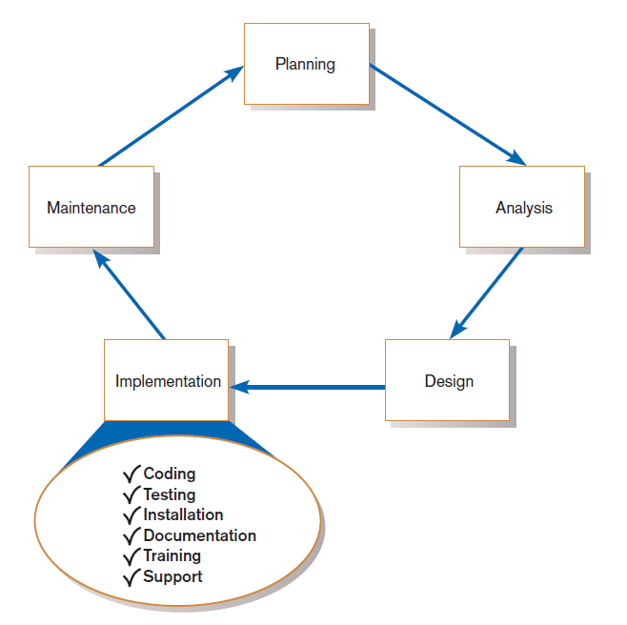
FIGURE 13-1
Systems development life cycle with the implementation phase highlighted

Slide 8
System Implementation
Six major activities:
Coding
Testing
Installation
Documentation
Training
Support

Slide 9
System Implementation (Cont.)
Purpose:
To convert final physical system specifications into working and reliable software
To document work that has been done
To provide help for current and future users

Slide 10
The Process of Coding, Testing, and Installation
Coding
Physical design specifications are turned into working computer code.
Testing
Tests are performed using various strategies.
Testing is performed in parallel with coding.
Installation
The current system is replaced by a new system.

Slide 11
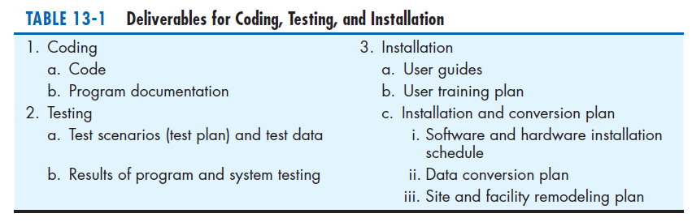

Slide 12
Documenting the System, Training Users, and Supporting Users
Two audiences for final documentation:
Information systems personnel who will maintain the system throughout its productive life
People who will use the system as part of their daily lives
User Training
Application-specific
General for operating system and off-the-shelf software

Slide 13
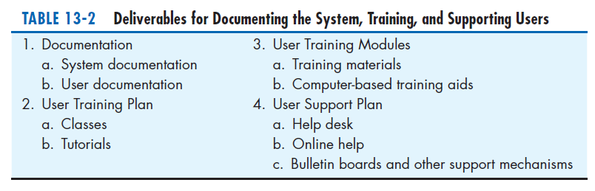

Slide 14
Software Application Testing
A master test plan is developed during the analysis phase.
During the design phase, unit, system and integration test plans are developed.
The actual testing is done during implementation.
Written test plans provide improved communication among all parties involved in testing.

Slide 15
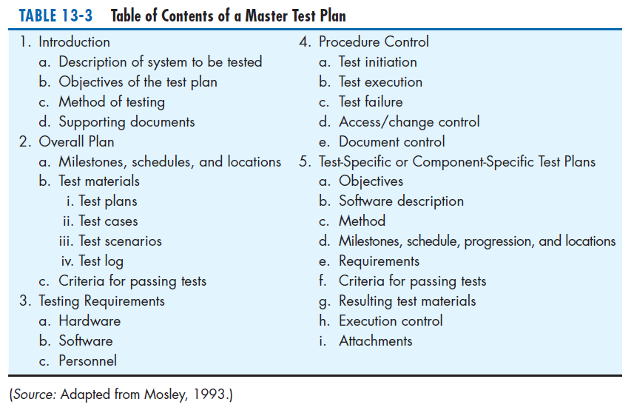

Slide 16
Seven Different Types of Tests
Static or dynamic techniques
Static testing means that the code being tested is not executed.
Dynamic testing involves execution of the code.
Test is automated or manual
Automated means computer conducts the test.
Manual means that people complete the test.

Slide 17
Seven Different Types of Tests
Inspection: a testing technique in which participants examine program code for predictable language-specific errors
Walkthrough: a peer group review of any product created during the systems development process, including code
Desk checking: a testing technique in which the program code is sequentially executed manually by the reviewer

Slide 18
Seven Different Types of Tests (Cont.)
Unit testing: each module is tested alone in an attempt to discover any errors in its code
Integration testing: the process of bringing together all of the modules that a program comprises for testing purposes
Modules are typically integrated in a top-down incremental fashion.

Slide 19
Seven Different Types of Tests (Cont.)
System testing: the bringing together of all of the programs that a system comprises for testing purposes
Programs are typically integrated in a top-down, incremental fashion.

Slide 20
Seven Different Types of Tests (Cont.)
Stub testing: a technique used in testing modules, especially where modules are written and tested in a top-down fashion, where a few lines of code are used to substitute for subordinate modules

Slide 21
The Testing Process
The purpose of testing is to confirm that the system satisfies the requirements.
Testing must be planned.
Test case is a specific scenario of transactions, queries or navigation paths.

Slide 22
The Testing Process (Cont.)
Test cases represent either:
Typical system use
Critical system use, or
Abnormal system use.
Test cases and results should be thoroughly documented so they can be repeated for each revision of an application.

Slide 23
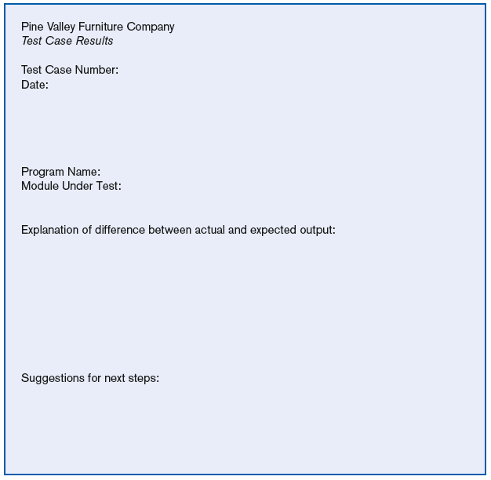
FIGURE 13-4
Test case results form
(Source: Adapted from
Mosley, 1993.)

Slide 24
Testing Harness
Automated testing environment
Reviews code for:
Errors
Standards violations
Other design flaws
Expand the scope of the tests beyond the current development platform

Slide 25
Testing Harness (Cont.)
Figure 13-5
NUnit, a unit testing framework for .NET

Slide 26
Combining Coding and Testing
Coding and testing often go together.
Big companies have dedicated test staff.
With eXtreme programming (XP) a common technique is refactoring.
Refactoring = making a program simpler after adding a new feature

Slide 27
Acceptance Testing by Users
Acceptance testing: the process whereby actual users test a completed information system, the end result of which is the users’ acceptance of it

Slide 28
Acceptance Testing by Users (Cont.)
Alpha testing: user testing of a completed information system using simulated data
Beta testing: user testing of a completed information system using real data in the real user environment

Slide 29
Acceptance Testing by Users (Cont.)
Types of Alpha Test:
Recovery testing — forces software (or environment) to fail in order to verify that recovery is properly performed
Security testing — verifies that protection mechanisms built into the system will protect it from improper penetration
Stress testing — tries to break the system
Performance testing — determines how the system performs on the range of possible environments in which it may be used

Slide 30
Installation
Installation: the organizational process of changing over from the current information system to a new one
Four installation strategies:
Direct Installation
Parallel Installation
Single-location installation
Phased Installation

Slide 31
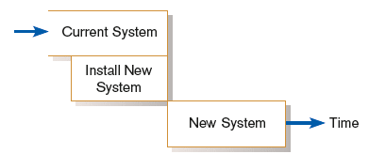
Direct Installation
Direct installation: changing over from the old system to a new one by turning off the old system when the new system is turned on

Slide 32
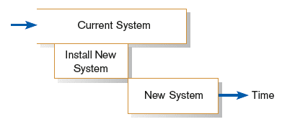
Parallel Installation
Parallel installation: running the old information system and the new one at the same time until management decides the old system can be turned off

Slide 33
Single-Location Installation
Single-location installation: trying out an information system at one site and using the experience to decide if and how the new system should be deployed throughout the organization
Also known as location or pilot installation

Slide 34
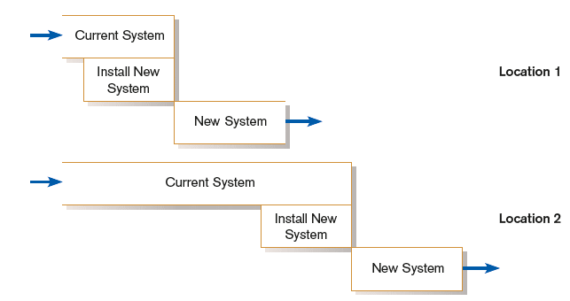
Single-Location Installation (cont.)

Slide 35
Phased Installation
Phased Installation: changing from the old information system to the new one incrementally, starting with one or a few functional components and then gradually extending the installation to cover the whole new system

Slide 36
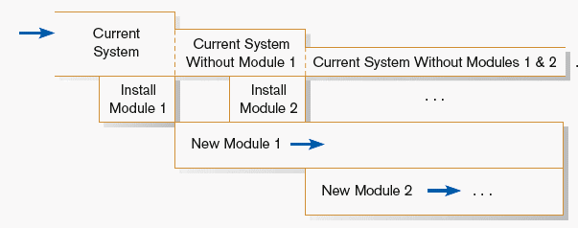
Phased Installation (cont.)

Slide 37
Planning Installation
Considerations
Data conversion
Error correction
Loading from current system
Planned system shutdown
Business cycle of organization

Slide 38
Documenting the System
System documentation: detailed information about a system’s design specifications, its internal workings, and its functionality
User documentation: written or other visual information about an application system, how it works, and how to use it

Slide 39
Documenting the System (Cont.)
Internal documentation: system documentation that is part of the program source code or is generated at compile time
External documentation: system documentation that includes the outcome of structured diagramming techniques such as data flow and E-R diagrams

Slide 40
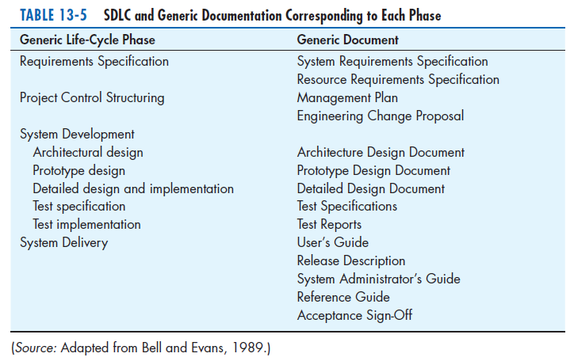

Slide 41
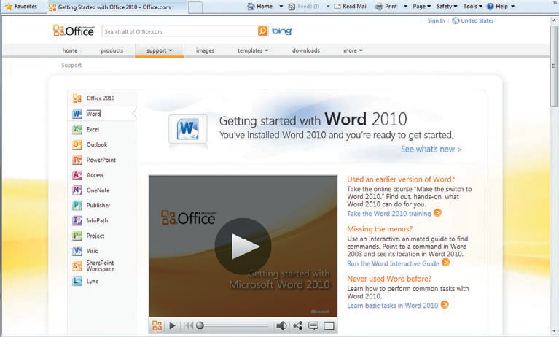
Figure 13-7
Example of online user documentation
(Source: Microsoft Corporation.)

Slide 42
Generic User’s Guide Outline
Preface
1. Introduction
1.1. Configurations
1.2 Function flow
2. User interface
2.1 Display screens
2.2 Command types
3. Getting started
3.1 Login
3.2 Logout
3.3 Save
3.4 Error recovery
3.n [Basic procedure name]
n. [Task name]
Appendix A—Error Messages
([Appendix])
Glossary
Terms
Acronyms
Index
Source: Adapted from Bell and Evans, 1989.)

Slide 43
Training and Supporting Users
Support: providing ongoing educational and problem-solving assistance to information system users
For in-house developed systems, support materials and jobs will have to be prepared or designed as part of the implementation process.

Slide 44
Training Information Systems Users
Potential training topics
Use of the system
General computer concepts
Information system concepts
Organizational concepts
System management
System installation

Slide 45
Types of Training Methods
Resident expert
Traditional instructor-led classroom training
E-learning, distance learning
Blended learning (instructor plus e-learning)
Software help components
External sources (e.g. vendors)

Slide 46
Training Information Systems Users (Cont.)
Electronic performance support system (EPSS): component of a software package or an application in which training and educational information is embedded
An EPSS can take several forms, including a tutorial, an expert system shell, and hypertext jumps to reference materials.

Slide 47
Supporting Information Systems Users
Support is important to users, but has often been inadequate.
Providing support can be expensive and time-consuming.
Vendors usually charge for their support, using 900- numbers, or charge a fee for unlimited or monthly support.

Slide 48
Automating Support
One approach is through automation.
Internet-based online support forums
On-demand fax
Voice response systems
Knowledge bases

Slide 49
Providing Support Through a Help Desk
Help desk: a single point of contact for all user inquiries and problems about a particular information system or for all users in a particular department

Slide 50
Providing Support Through a Help Desk (Cont.)
Requires
Technical skills: extensive knowledge about how to use the system and typical problems that can be encountered
People skills: good listening and communication, dealing with complaints and frustrations

Slide 51
Support Issues for the Analyst to Consider
User questions and problems
Recovery and backup
Disaster recovery
PC maintenance
Writing newsletters
Setting up user groups

Slide 52
Organizational Issues in Systems Implementation
Why does implementation sometimes fail?
Traditional wisdom of primary success factors:
Management support
User involvement
But these are not enough
Other important factors
Commitment to project
Commitment to change
Extent of project definition and planning

Slide 53
Factors Influencing System Use
Personal stake of users
System characteristics
User demographics
Organizational support
Performance
Satisfaction

Slide 54
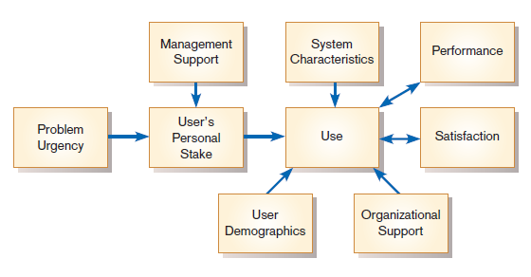
Success Factors
Figure 13-10
Implementation success
(Source: Adapted from Lucas, H. C. 1997.Information Technology for Management. New York: McGraw-Hill, with the permission of the McGraw-Hill Companies. All rights reserved.)

Slide 55
Security Issues
Increasingly important issue for organizations and their management
Malicious software (malware): includes Trojan horses, worms, viruses, and other kinds
External sources of threats include laptop theft, system penetration, and denial of service.

Slide 56
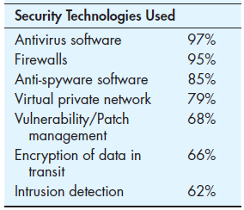
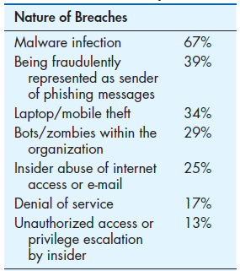
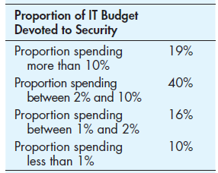
Table 13-8 Selected Statistics on IT Security
(Source: Data from Computer Security
Institute [Richardson], 2011.)

Slide 57
Electronic Commerce Application: System Implementation for Pine Valley Furniture’s Web-Store
Developing test cases for the Web-Store include testing categories as follows:
Simple functionality
Multiple functionality
Function chains
Elective functions
Emergency/crisis

Slide 58
Developing Test Cases for Web-Store
Test case forms had the following sections:
Test Case ID
Category/Objective of Test
Description
System Version
Completion Date
Participants
Machine Characteristics (processor, operating system, memory, browser, etc.)
Test Result
Comments

Slide 59
Bug Tracking and System Evolution
Bug-tracking form has the following categories:
Bug Number (simple incremental number)
Test Case ID that Generated the Bug
Is the Bug Replicable?
Effects
Description
Resolution
Resolution Date
Comments
As batches of bugs are fixed, the version number of the software is incremented (below 1.0 during development and testing).

Slide 60
Alpha and Beta Testing the Web-Store
Alpha Testing:
PVF employees who actively participated received a t-shirt and $100 to shop.
Development team conducted extensive recovery, security, stress, and performance testing.
Beta Testing
PVF recruited several of their established customers to help in beta testing.

Slide 61
Web-Store Installation
WebStore was ready to go online and development team recommended to top management that it was time to “flip the switch”.

Slide 62
Project Close-Down
Evaluate team.
Reassign members to other projects.
Notify all affected parties that the development project is ending and that you are switching to operation and maintenance mode.
Conduct post project reviews.
Close out customer contract.
Formal signoff

Slide 63
Summary
In this chapter you learned how to:
Describe the process of coding, testing, and converting an organizational information system and outline the deliverables and outcomes of the process.
Prepare a test plan for an information system.
Apply four installation strategies: direct, parallel, single-location, and phased installation.
List the deliverables for documenting the system and for training and supporting users.

Slide 64
Summary (Cont.)
Compare the many modes available for organizational information system training, including self-training and electronic performance support systems.
Discuss the issues of providing support for end-users.
Explain why system implementation sometimes fails.
Describe the threats to system security and remedies that can be applied.
Show how traditional implementation issues apply to electronic commerce applications.

Slide 65
Maintaining Information Systems
References - - - - - - - - Valacich and George, Modern Systems Analysis and Design, 8th Ed., Pearson, Chapter 14

Slide 66
Learning Objectives
Explain and contrast four types of system maintenance.
Describe several factors that influence the cost of maintaining an information system and apply these factors to the design of maintainable systems.
Describe maintenance management issues, including alternative organizational structures, quality measurement, processes for handling change requests, and configuration management.
Explain the role of CASE tools in maintaining information systems.

Slide 67
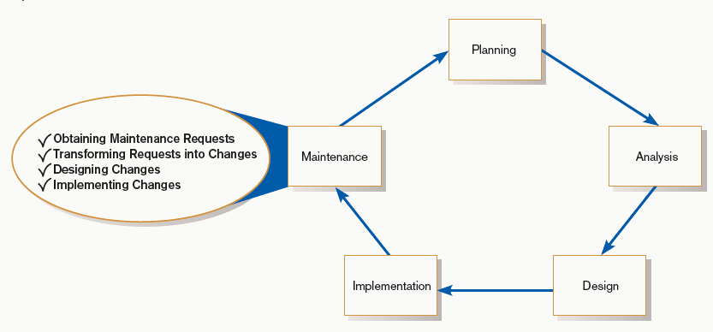
Maintaining Information Systems
FIGURE 14-1
Systems development life cycle

Slide 68
The Process of Maintaining Information Systems
Process of returning to the beginning of the SDLC and repeating development steps focusing on system change until the change is implemented
Maintenance is the longest phase in the SDLC.

Slide 69
The Process of Maintaining Information Systems (Cont.)
Four major activities:
Obtaining maintenance requests
Transforming requests into changes
Designing changes
Implementing changes

Slide 70
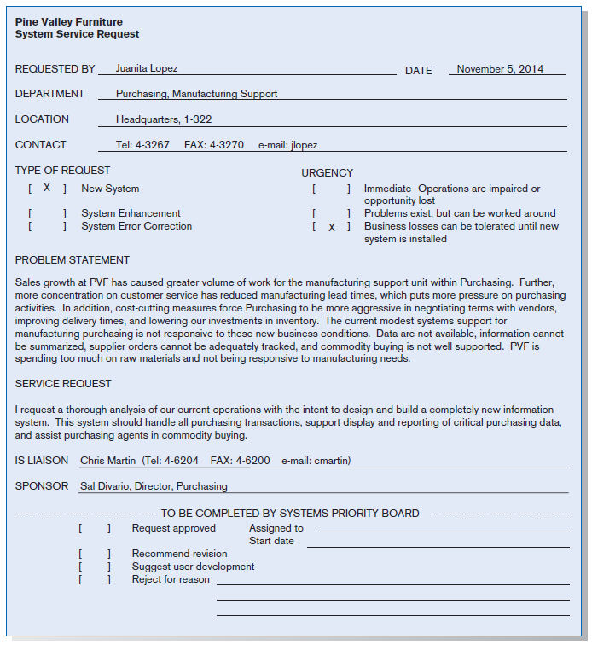
FIGURE 14-2
System Service Request for purchasing
fulfillment system (Pine Valley Furniture)

Slide 71
Deliverables and Outcome
The maintenance phase of the SDLC is basically a subset of the activities of the entire development process.

Slide 72
Deliverables and Outcome (Cont.)
The deliverables and outcomes from the process are the development of a new version of the software and new versions of all design documents created or modified during the maintenance effort.

Slide 73
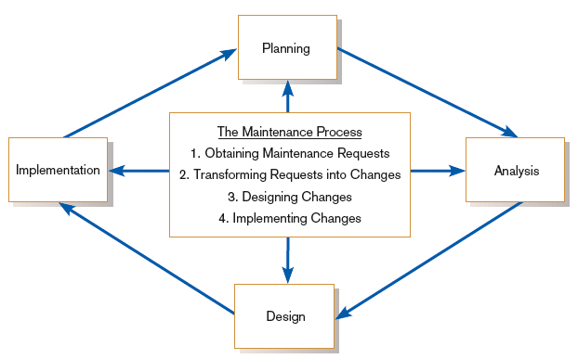
Deliverables and Outcome (Cont.)
FIGURE 14-3
Maintenance activities parallel those of
the SDLC

Slide 74
Types of System Maintenance
Maintenance: changes made to a system to fix or enhance its functionality
Corrective maintenance: changes made to a system to repair flaws in its design, coding, or implementation
Adaptive maintenance: changes made to a system to evolve its functionality to changing business needs or technologies
Perfective maintenance: changes made to a system to add new features or to improve performance
Preventive maintenance: changes made to a system to avoid possible future problems

Slide 75
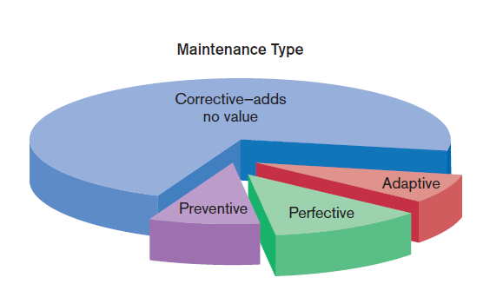
Types of System Maintenance (Cont.)
Figure 14-4
Value and non-value adding of different types of maintenance (Sources: Based on Andrews and Leventhal,1993; Pressman, 2005.)

Slide 76
The Cost of Maintenance
Many organizations allocate 60-80% of information systems budget to maintenance.
Maintainability: the ease with which software can be understood, corrected, adapted, and enhanced

Slide 77
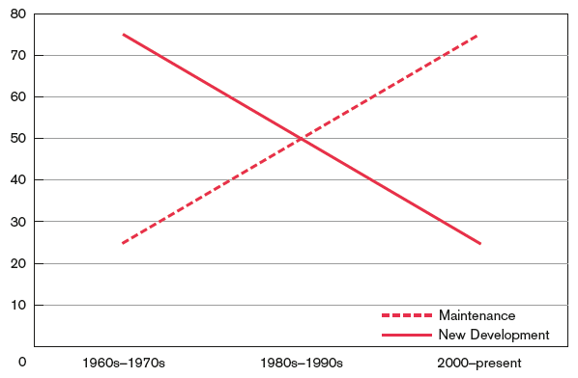
The Cost of Maintenance (Cont.)
FIGURE 14-5
New development versus maintenance as a percentage of the software budget over the years
(Source: Based on Pressman, 2005.)

Slide 78
The Cost of Maintenance (Cont.)
Factors that influence system maintainability:
Latent defects
Number of customers for a given system
Quality of system documentation
Maintenance personnel
Tools
Well-structured programs

Slide 79
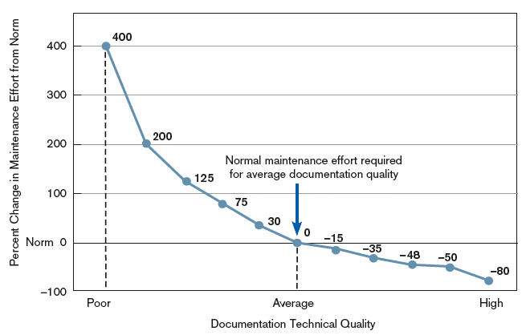
The Cost of Maintenance (Cont.)
FIGURE 14-6
Quality documentation eases Maintenance
(Source: Based on Hanna, M. 1992.
“Using Documentation as a Life-Cycle Tool.” Software Magazine [December]: 41–46.)

Slide 80
Managing Maintenance Personnel
Number of people working in maintenance has surpassed number working in development.
Maintenance work is often viewed negatively by IS personnel.
Organizations often rotate personnel in and out of maintenance roles in order to lessen negative feelings about maintenance.
Organizations have historically rewarded people involved in new development better than maintenance personnel.

Slide 81
Managing Maintenance Personnel (Cont.)
Three possible organizational structures:
Separate — maintenance group consists of different personnel than development group
Combined — developers also maintain systems
Functional — maintenance personnel work within the functional business unit

Slide 82
Managing Maintenance Personnel (Cont.)
Maintenance Organization Type | Advantages | Disadvantages
Separate | Improved system and documentation quality | Ignorance of critical undocumented information
Combined | Maintenance group knows all about system | Less emphasis on good documentation
Functional | Personnel have vested interest | Limited job mobility and human or technical resources

Slide 83
Measuring Maintenance Effectiveness
Must measure the following factors:
Number of failures
Time between each failure
Type of failure
Mean time between failures (MTBF): a measurement of error occurrences that can be tracked over time to indicate the quality of a system

Slide 84
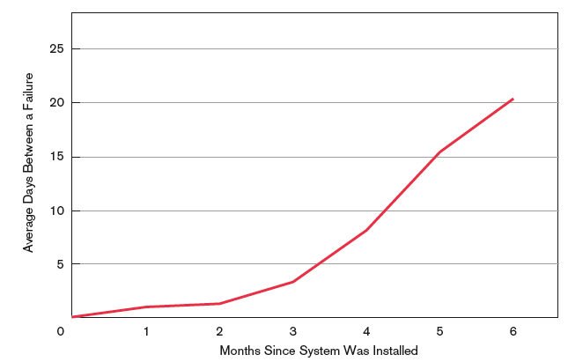
Measuring Maintenance Effectiveness (Cont.)
FIGURE 14-7
How the mean time between failures
should change over time

Slide 85
Controlling Maintenance Requests
Maintenance requests can be frequent.
Prioritize based on type and urgency of request.
Evaluations are based on feasibility analysis.

Slide 86
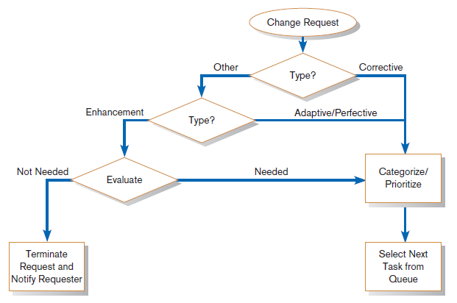
Controlling Maintenance Requests (Cont.)
FIGURE 14-8
How to prioritize maintenance requests

Slide 87
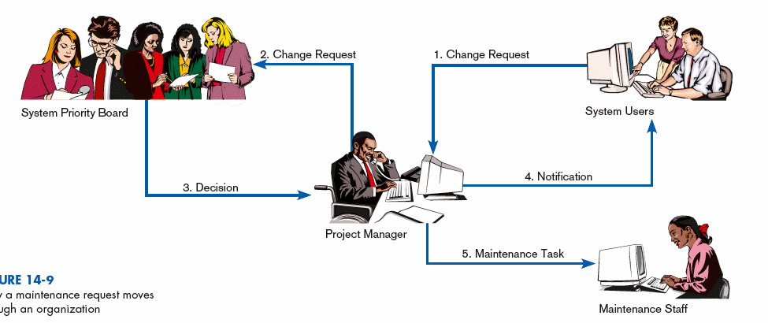
Controlling Maintenance Requests (Cont.)
FIGURE 14-9
How a maintenance request moves
through an organization

Slide 88
Configuration Management
Configuration management: the process of ensuring that only authorized changes are made to the system
Baseline modules: software modules that have been tested, documented, and approved to be included in the most recently created version of a system

Slide 89
Configuration Management (Cont.)
System librarian: a person responsible for controlling the checking out and checking in of baseline modules when a system is being developed or maintained
Build routines: guidelines that list the instructions to construct an executable system from the baseline source code

Slide 90
Role of CASE and Automated Development Tools in Maintenance
Traditional systems development
Emphasis is on coding and testing.
Changes are implemented by coding and testing first.
Documentation is done after maintenance is performed.
Keeping documentation current is often neglected due to time-consuming nature of task.

Slide 91
Role of CASE and Automated Development Tools in Maintenance (Cont.)
Development with CASE
Emphasis is on design documents.
Changes are implemented in design documents.
Code is regenerated using code generators.
Documentation is updated during maintenance.

Slide 92
Role of CASE and Automated Development Tools in Maintenance (Cont.)
Reverse engineering: automated tools that read program source code as input and create graphical and textual representations of design-level information such as program control structures, data structures, logical flow, and data flow

Slide 93
Role of CASE and Automated Development Tools in Maintenance (Cont.)
Reengineering: automated tools that read program source code as input; perform an analysis of the program’s data and logic; and then automatically, or interactively with a systems analyst, alter an existing system in an effort to improve its quality or performance

Slide 94
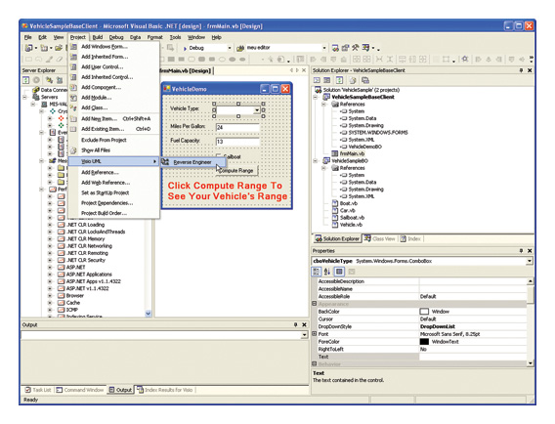
Role of CASE and Automated Development Tools in Maintenance (Cont.)
Figure 14-10 Visual Studio .NET engineer applications into Visio UML diagrams (Source: Microsoft Corporation.)

Slide 95
Web Site Maintenance
Special considerations:
24 X 7 X 365
Nature of continuous availability makes maintenance challenging.
Pages under maintenance can be locked.
Consider using date and time stamps to indicate when changes are made instead.

Slide 96
Web Site Maintenance (Cont.)
Check for broken links
HTML Validation
Pages should be processed by a code validation routine before publication.
Reregistration
When content significantly changes, site may need to be reregistered with search engines. Future Editions
Consistency is important to users.
Post indications of future changes to the site.
Batch changes.

Slide 97
Electronic Commerce Application: Maintaining an Information System for Pine Valley Furniture’s Web-Store
To maintain PVF’s WebStore, the following questions need to be addressed:
“How much is our Web site worth?”
“How much does it cost our company when our Web site goes down?”
“How reliable does our Web site need to be?”

Slide 98
Electronic Commerce Application: Maintaining an Information System for Pine Valley Furniture’s WebStore (Cont.)
Pine Valley Furniture needs to immediately develop a plan for addressing the WebStore’s service level problems.

Slide 99
Summary
In this chapter you learned how to:
Explain and contrast four types of system maintenance.
Describe several facts that influence the cost of maintaining an information system and apply these factors to the design of maintainable systems.
Describe maintenance management issues, including alternative organizational structures, quality measurement, processes for handling change requests, and configuration management.
Explain the role of CASE tools in maintaining information systems.

